Slide 1
Maharaja Agrasen Institute of Management & Technology
Seminar
Fuzzy Logic and Fuzzy System
Under the guidance of: Presented by:
Ms. Anchal Sahota Kajal
Assistant Professor College Roll No. 245040, 4th Semester
Department of Computer Applications Bachelor of Computer Applications (2024-27)

Slide 2
Outline
Introduction to Fuzzy Logic
Basics Concept of Fuzzy Logic
Architecture of Fuzzy Logic System
Working of Fuzzy Logic System
Fuzzy Logic in Artificial Intelligence
Applications of Fuzzy Logic in real life
Advantages of Fuzzy Logic and System
Disadvantages of Fuzzy Logic and System
Conclusion

Slide 3
Introduction to Fuzzy Logic
Fuzzy Logic is a technique used to handle uncertainty and imprecise information.
Unlike Boolean logic that works with only 0 or 1, fuzzy logic allows values between 0 and 1.
It is widely used in AI, control systems, and decision-making applications.

Slide 4
Basics Concepts of Fuzzy Logic
Fuzzy Sets
Membership Function
Linguistic Variables
Degrees of Truth

Slide 5
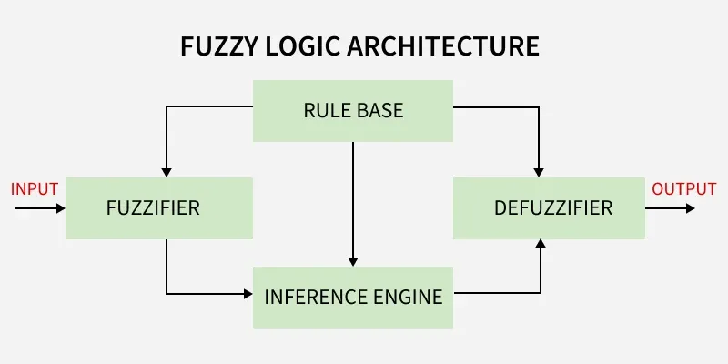
Architecture of Fuzzy Logic System
Crisp Inputs
Fuzzification
Knowledge Base
Inference Engine
Defuzzification

Slide 6
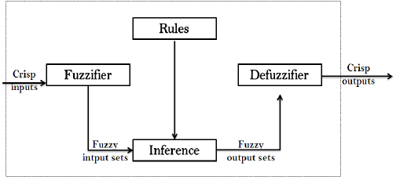
Working of Fuzzy Logic System
Input Collection (Crisp Inputs)
Fuzzification of Inputs
Rule Evaluation Using the Rule Base
Inference Process
Aggregation of Rule Outputs
Defuzzification of Output

Slide 7
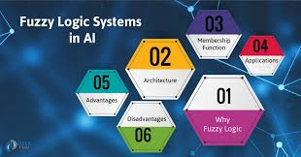
Fuzzy Logic in Artificial Intelligence
Antivirus Software
Regular Updates
Firewalls
User Awareness
Safe Browsing Practices

Slide 8
Applications of Fuzzy Logic in Real life
Home Appliances
Consumer Electronics
Automotive Industry
Medical and Healthcare Systems
Cybersecurity(Antivirus & Firewalls)
Games & AI

Slide 9
Advantages of Fuzzy Logic and System
Handles Uncertainty and Vagueness
Human-Like Reasoning
Simple and Easy to Understand
Flexible System Design
No Need for Accurate Mathematical Models
Effective in Complex Systems

Slide 10
Disadvantages of Fuzzy Logic and System
Lack of Precision
Dependency on Expert Knowledge
No Standard Design Method
Complex Rule Design
No Self-Learning Capability
High Computational Cost

Slide 11
Reference video
Watch the Reference Video

Slide 12
Conclusion
Fuzzy Logic is an effective approach for dealing with uncertainty and imprecise information present in real-world problems. Unlike traditional Boolean logic, it uses degrees of truth, which makes decision-making more natural and closer to human reasoning. Fuzzy Systems are flexible, easy to understand, and adaptable, and they are widely applied in artificial intelligence, control systems, and everyday technologies. Despite a few limitations, fuzzy logic remains a powerful and practical tool for intelligent system design.

Slide 13
Thanks

